Slide 1

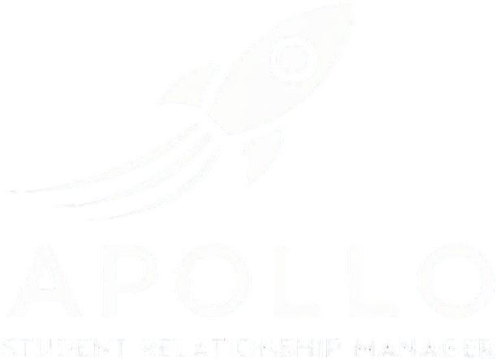

Mission Control
for Student Success
Smart. Simple. Seamless.
The Future of Student Relationship Management.
ApolloSRM = SIS + CRM
Houston, we have a solution! ApolloSRM is the integrated Student Information System (SIS) and Customer Relationship Management (CRM) platform that effortlessly launches your college to new heights. Like NASA's famed Apollo program, our software is carefully engineered to guide your institution smoothly through every phase of the student lifecycle—from first contact to graduation and beyond.
Modern AI-Focused Software
Apollo’s AI-first design ensures your system is future-ready and easy to use. It integrates seamlessly with your existing infrastructure, making data more accessible while streamlining operations, boosting productivity, and driving growth.
Reliable and Extendable
Our expert team builds secure, scalable systems that integrate seamlessly with your existing tech. Designed to fuel growth and innovation, our solutions keep you efficient, competitive, and ready to reach your goals with confidence.
Liftoff With Powerful Features
Advanced Automated Admissions and CRM
Comprehensive Student Information Management
Robust Reporting and Regulatory Tools
Integrated Accounting and Financial Management
AI-Powered Business Analytics
Interactive Mobile Self-Service Portals for Students and Faculty
Seamless Integration with Third-Party Systems
Ready for Launch?
Take one small step for your institution and one giant leap for student success with ApolloSRM. Let's ignite your institutional potential together!
ApolloSRM—guiding your institution from launchpad to orbit, and beyond.

